Slide 1

Classifying Failures in Defect Elimination Platform

Slide 2
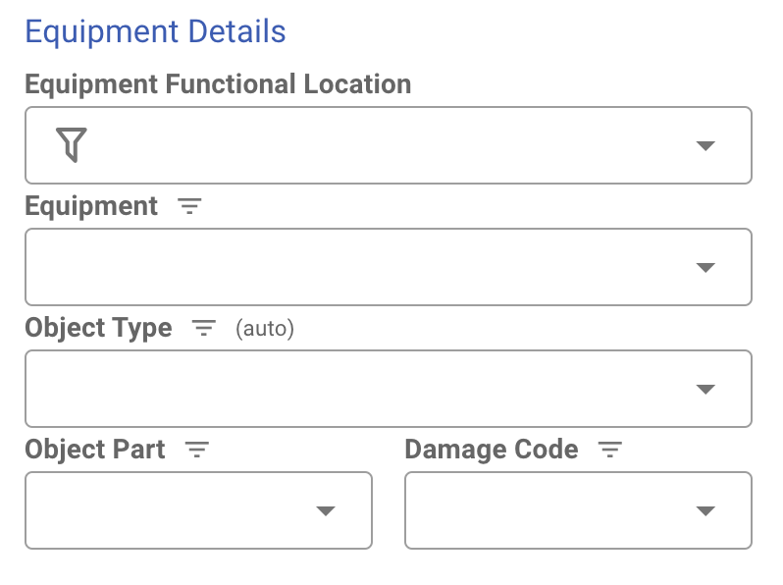

Component

Slide 3
Logic Paths
APT-IL-CNVY-CONVEY-CV0909-CLEAN
Function Location filters Equipment
Scraper Belt Diagonal Plough
Equipment filters a unique Object Type
Path One
Path Two
Belt Scraper
Stator
Use unique value
Change unique value from list of all Object Types
Some policy filters these values
A different policy filters these values

Slide 4
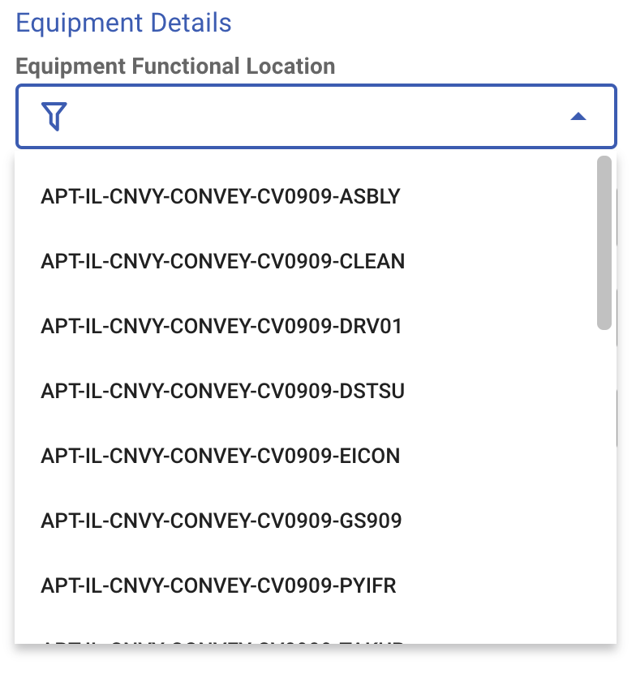
Equipment Function Location

Slide 5
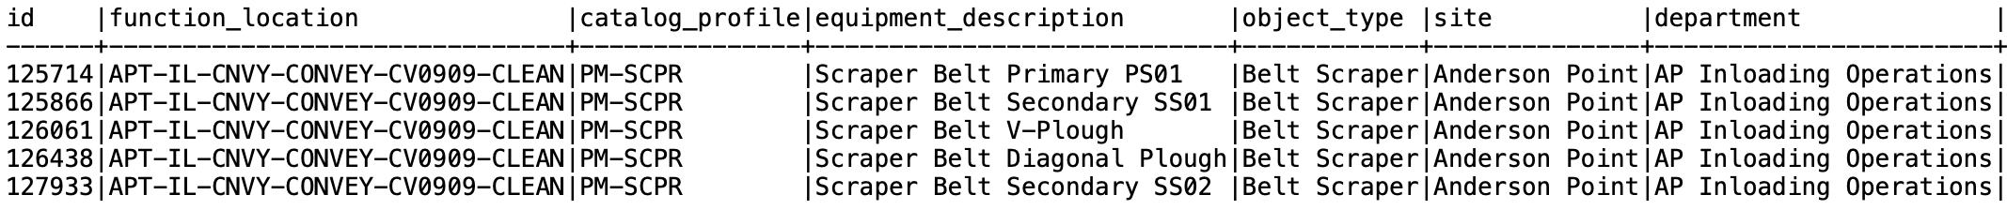
Function Location Filters Equipment
Equipment Table

Slide 6
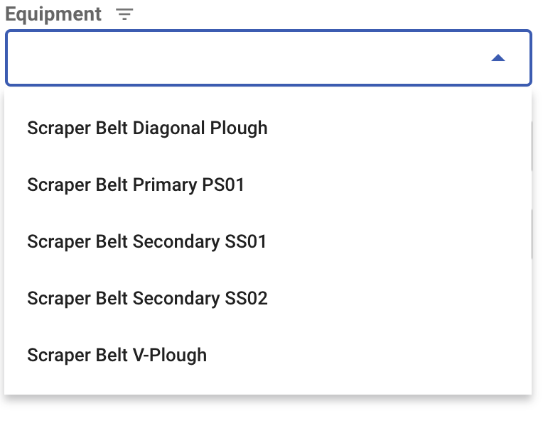
Equipment

Slide 7
Equipment Filters Object Type
Equipment Table
We now have a unique Object Type
Belt Scraper
The Catalog Profile is used to reference the Object Code table
PM-SCPR

Slide 8
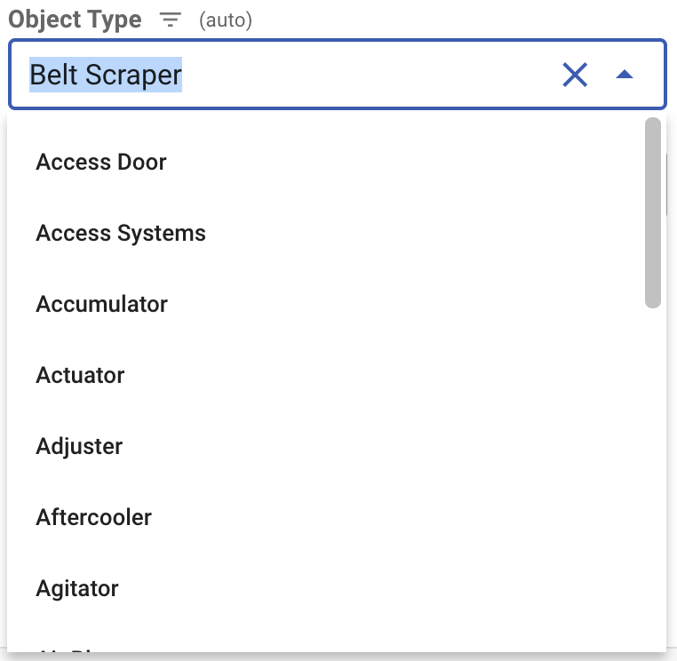
Object Type
Path One
Path Two

Slide 9
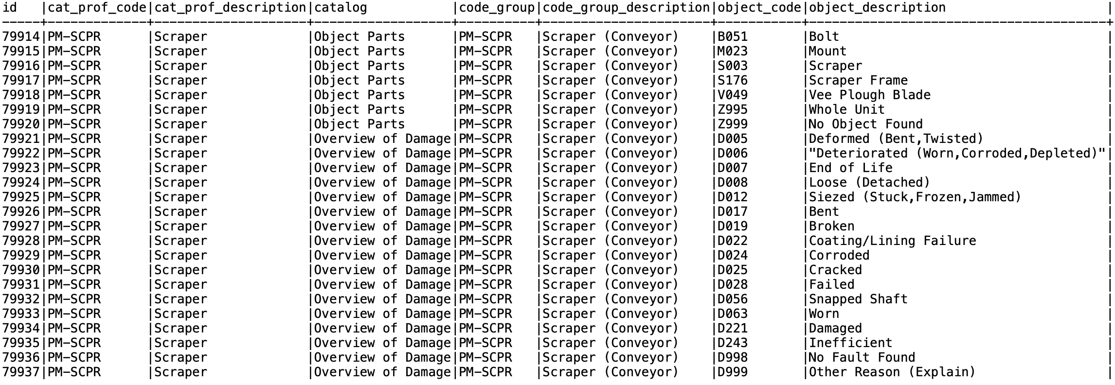
Path One Policy for selecting Object Part and Damage Codes
Keep the auto populated Object Type (Belt Scraper) which links to a single Catalog Profile (PM-SCPR)
Object Code Table
Catalog Profile Code (PM-SCPR) and Catalog filter the lists for Object Parts and Damage Codes in the component

Slide 10
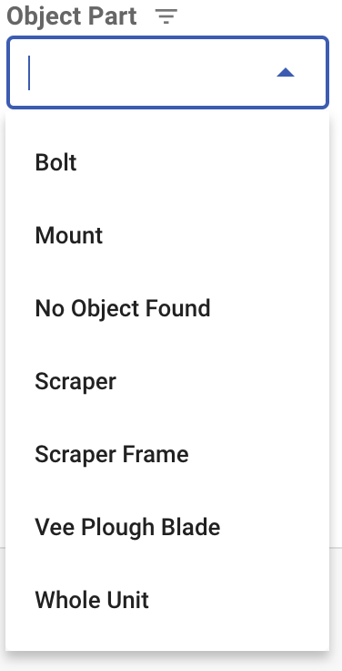
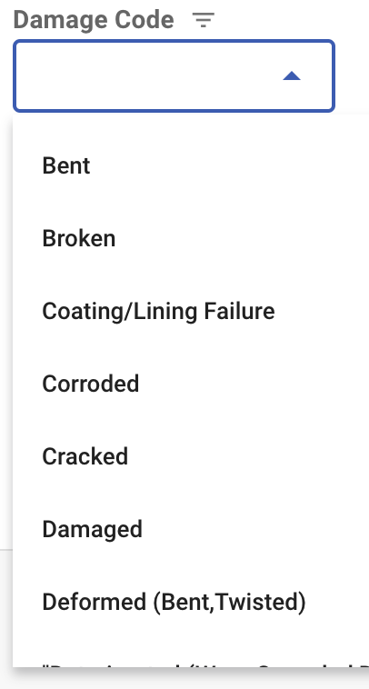
Object Part and Damage Codes (Path One)

Slide 11
Path Two Policy for selecting Object Part and Damage Codes
Suppose that the auto populated Object Type was changed from Belt Scraper to Stator
Path One
Stator

Slide 12
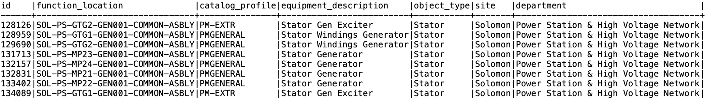
Path Two Policy for selecting Object Part and Damage Codes
Equipment Table
We can no longer rely on the function location or equipment description to get a unique Catalog Profile
We are left with a list of Catalog Profiles instead of one
PM-EXTR, PMGENERAL

Slide 13
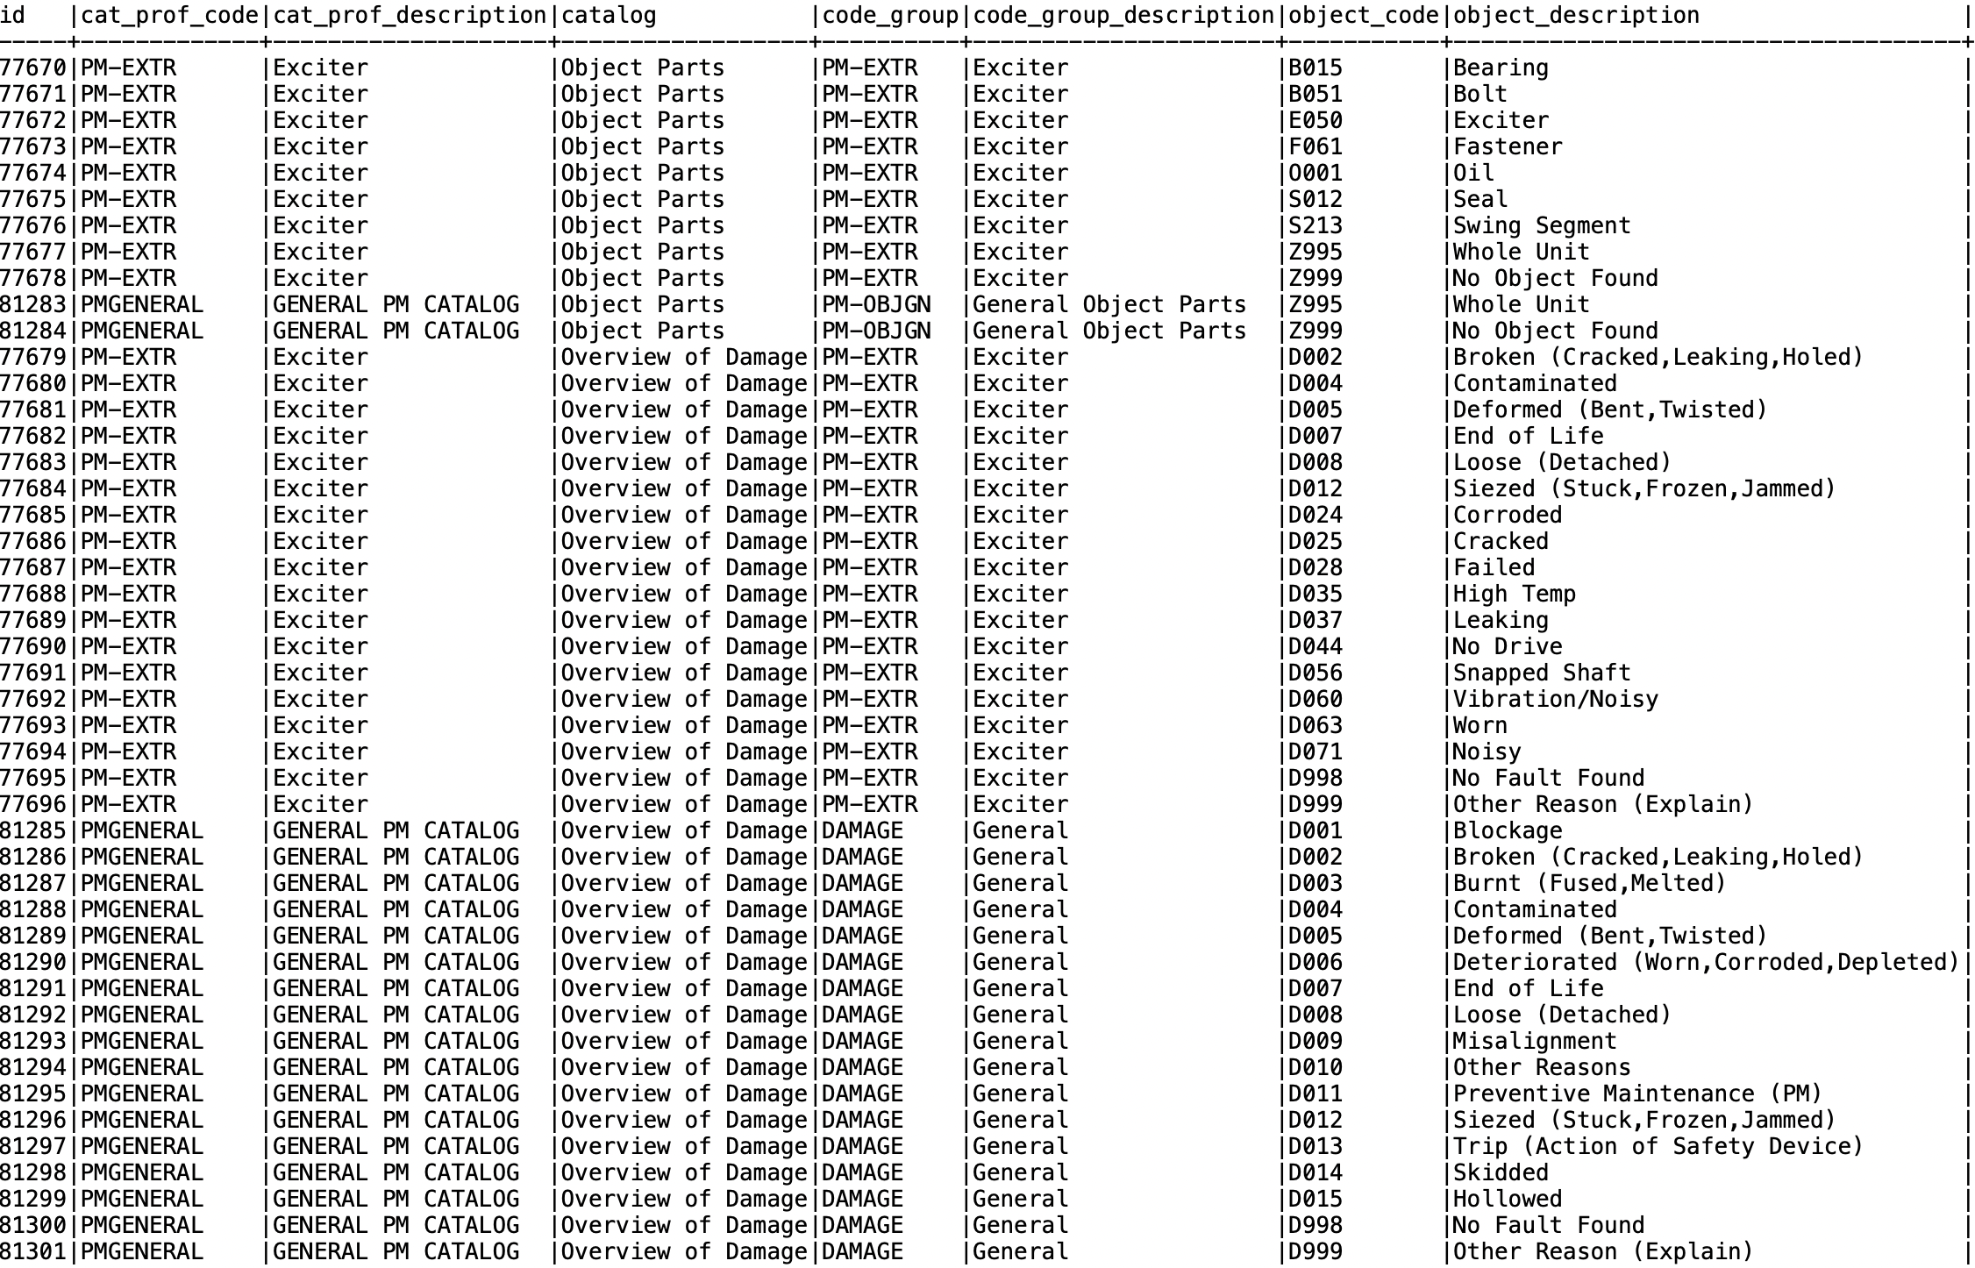
Path Two Policy for selecting Object Part and Damage Codes
List of Catalog Profile Codes (PM-EXTR, PMGENERAL) and Catalog will filter the lists for Object Parts and Damage Codes in the component
Object Code Table

Slide 14
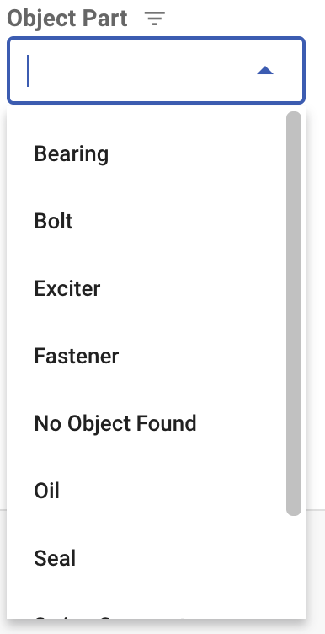
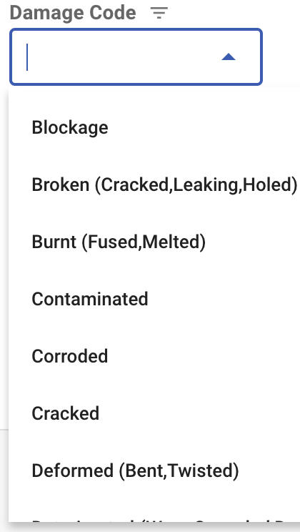
Object Part and Damage Codes (Path Two)

Slide 15
Data
SELECT "FLOC"."functional_location", "FLOC"."catalog_profile", "FLOC"."equipment_description", "FLOC"."object_type",
"Site"."Description" as "site",
CASE WHEN "FLOC"."functional_location" LIKE '%-WTRS-%' THEN 'Dewatering'
ELSE "Department"."Description" END "department"
FROM
(
Select "FunctionalLocation" as "floc_id",
"FunctionalLocationLabel" as "functional_location",
"EquipmentDescription" as "equipment_description",
"TechnicalObjectTypeDescription" as "object_type",
"CatalogProfile" as "catalog_profile"
from "AA_ASSETS_MAINTENANCESYSTEMS"."QUERY"."EquipmentCurrent"
WHERE "FunctionalLocationLabel" LIKE '___-__-____-%'
) "FLOC"
LEFT OUTER JOIN
(Select "FunctionalLocationLabel" as "functional_location",
"FunctionalLocationDescription" as "Description"
from "AA_ASSETS_MAINTENANCESYSTEMS"."QUERY"."FunctionalLocation"
WHERE "FunctionalLocationLabel" LIKE '___-__'
) "Department" ON "Department"."functional_location" = left("FLOC"."functional_location",6)
LEFT OUTER JOIN
(Select "FunctionalLocationLabel" as "functional_location",
"FunctionalLocationDescription" as "Description"
from "AA_ASSETS_MAINTENANCESYSTEMS"."QUERY"."FunctionalLocation"
WHERE "FunctionalLocationLabel" LIKE '___'
) "Site" ON "Site"."functional_location" = left("FLOC"."functional_location",3)
Equipment table: snowflake query
Defect Codes: csv file (not given here)

